Slide 1
How does creativity change the world?
Unit 2
Notes:
http://www.learner.org/interactives/renaissance/index.html

Slide 2
What is the Renaissance?

Slide 3
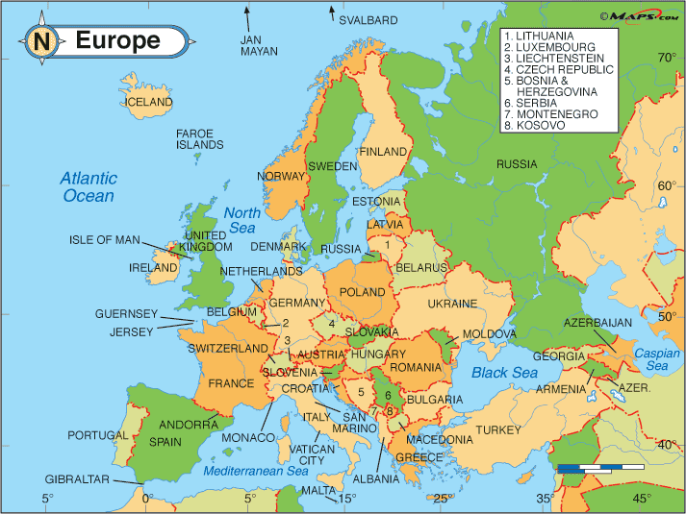
The Renaissance is…
the revival of art, literature, and learning that began in Italy in the 1300s and lasted into the 1600s.

Slide 4
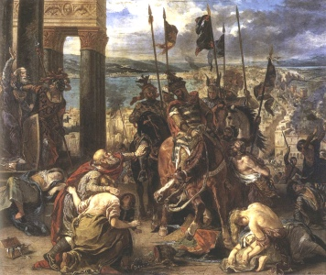
Before the Renaissance…
Europe was in the Middle Ages
Dark time period
People were sad and poor
Bubonic Plague (“Black Death”) killed many people
Famous Men of the Middle Ages
by John Henry Haaren
[1904]

Slide 5
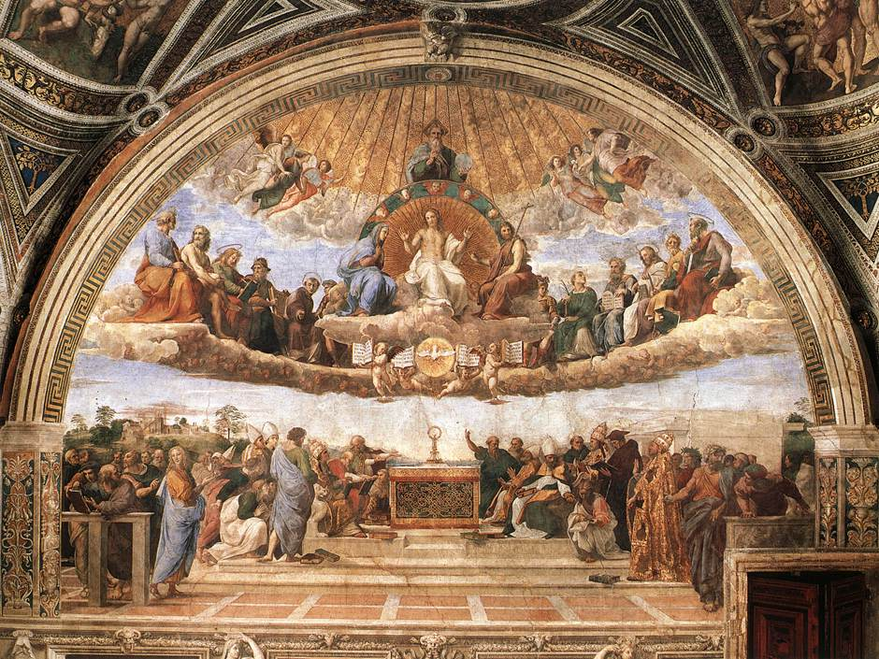
Renaissance
As people got healthier and the population grew, there was more time and money to focus on the arts and sciences

Slide 6
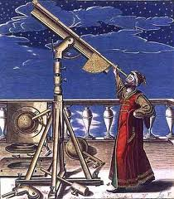
What came out of the Renaissance?
During the Renaissance, scholars, writers, and artists took an interest in the writings and ideas of classical Greek and Roman culture including:
SCIENCE
MATHEMATICS
ARCHETECTURE
ART
MUSIC
http://www.learn360.com/ShowVideo.aspx?ID=693312&SearchText=the+italian+renaissance

Slide 7
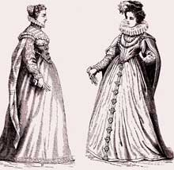
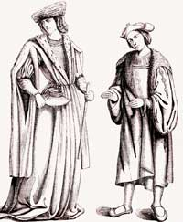
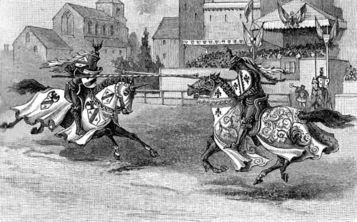
Life during the Renaissance
Meat was served only during special occasions
Salt was available to only the wealthy
Jousting was a popular sport
Women began showing hair again, wearing pretty veils and jewels
Men wore puffed sleeves

Slide 8
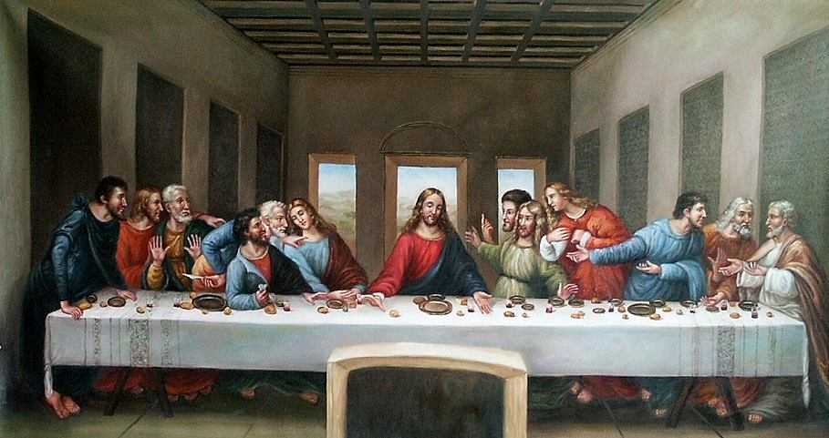
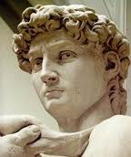
Renaissance Art
Sculpture
Painters
Realism
Poetry
Music
By Leonardo da Vinci c. 1495-98

Slide 9
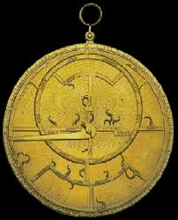
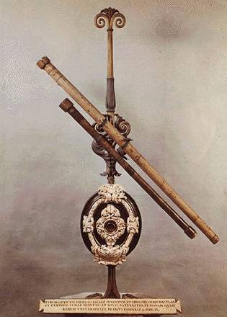
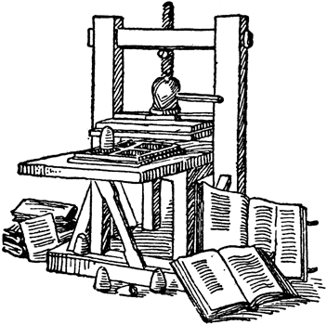
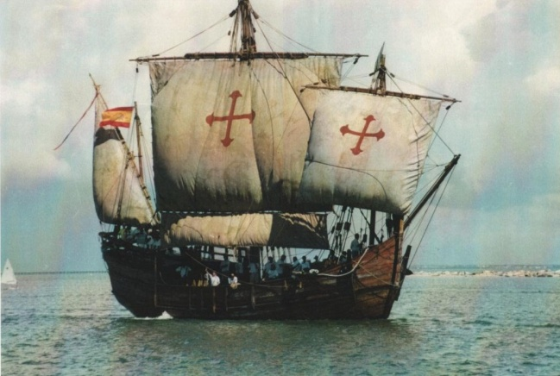
Technology of the Renaissance
Gutenberg’s printing press
Astrolabe
Portable clock
Telescope improvements
Exploration (ex. Christopher Columbus)

Slide 10
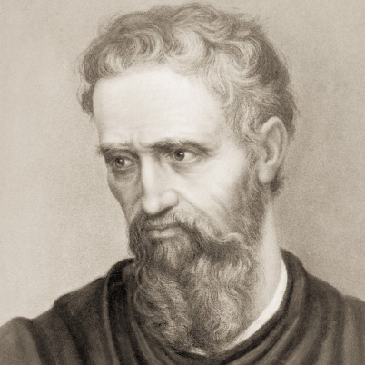
Michelangelo
1475-1564
Famous Italian sculptor,
architect, painter, and poet
Painted the ceiling of the Sistine Chapel
BrainPop- Michelangelo http://www.brainpop.com/socialstudies/famoushistoricalfigures/michelangelobuonarroti/preview.weml

Slide 11
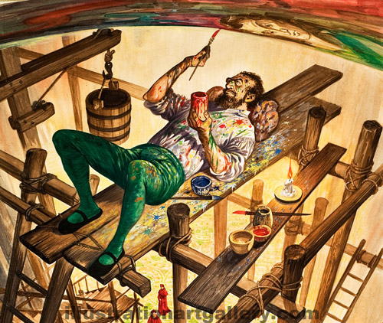
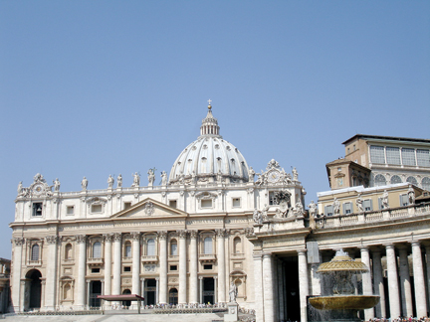
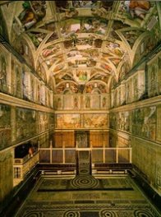
Sistine Chapel
Built between 1473-1481
Named for Pope Sixtus IV who had it built
Has 6,000 square feet of ceiling
Michelangelo painted it from 68 feet in the air
It took him 4 years to complete the project

Slide 12
Directions
Imagine the challenges Michelangelo faced while painting the ceiling of the Sistine Chapel.
Tape a piece of paper under your desk and draw a detailed picture for 10 minutes.

Slide 13
Reflection
What do you think it must have been like for Michelangelo to paint the ceiling?
Explain some of the difficult conditions

